Slide 1



Optional Practical Training (OPT) Tutorial
International Students and Scholars (ISS) Office
900 University Ave, Skye Hall 321
Riverside, CA 92521
(951) 827-4113
internationalstudents@ucr.edu
Notes:
Hello everyone!
Welcome to the Optional Practical Training Online tutorial presented by UC Riverside’s International Students and Scholar’s Office.

Slide 2
Topics to Cover Today
General OPT Information
OPT Timeline
  When to Apply
OPT Application Process
  Internal & External
International Travel and OPT
USCIS Decision
OPT Reporting Requirements
After OPT Ends
Notes:
In today’s OPT Tutorial, we will be primarily focusing on how to apply for Post-Completion OPT. We will be covering topics including:
General OPT information
OPT Application Timeline
OPT Application Process including the internal & external process
International Travel and OPT
USCIS Application Decision
OPT Reporting REquirements
And finally, what to do after your OPT ends

Slide 3
General OPT Information
Notes:
For our first topic, we will talk about general information about OPT

Slide 4
What is Optional Practical Training?
A benefit of F-1 visa allowing students to get some practical experience in their field of studies.
Basics of OPT
Gain practical experience in your field of study
Employment Benefit of F-1 student status
Authorized by USCIS
Standard OPT: authorized up to 12 months total
  Pre-Completion OPT (During Program of Study)
  Post-Completion OPT (After Program of Study) - Most Common
STEM OPT Extension: additional 24 months of OPT (only for eligible STEM majors)
Notes:
Optional Practical Training, also known as OPT, is a temporary employment benefit for F-1 students which allows them to gain practical experience in their field of study.
While the ISS office recommends students for OPT and helps them apply, it is USCIS that ultimately authorizes and approves OPT applications.
There are different types of OPT
First, there is standard 12-month OPT which includes:
Pre-Completion OPT - which is work authorization during the program of study
And Post-Completion OPT- which is work authorization after the program of study. Post-Completion OPT is the most common type of OPT used by students. We will be primarily focusing on this type of OPT today.
And finally, there is the 24-month STEM OPT Extension which is an extension of OPT benefit for students who graduated in eligible Science, Technology, Engineering, or Mathematics majors

Slide 5
Am I eligible to apply for OPT?
Strongly recommended to attend the OPT workshop/OPT Tutorial
Must be enrolled as full-time student for one full academic year (3 quarters)
Must be completed with course requirements for degree (excluding thesis or equivalent)
Must have approval from the academic department or Academic Advisor/Graduate Advisor
Only one OPT may be used at each degree level
1 year of full-time CPT will cancel your OPT opportunity
Do not need job offer at the time of OPT application
Job offer must be directly related to student’s field of study
Must be submitted to USCIS within 30 days from the date that OPT was recommended by ISS
Notes:
To be eligible to apply for OPT, you will need to meet the following criteria:
Firstly, we strongly recommend that you participate in an OPT workshop or an OPT tutorial
You must be enrolled as a full-time student for one full academic year
You must be completed with course requirements for degree (excluding thesis or equivalent)
You will also need to have approval from the academic department or Academic Advisor/Graduate Advisor
Please keep in mind that only one OPT may be used at each degree level
1 year of full-time CPT will cancel your OPT opportunity
You do not need a job offer at the time of OPT application
If you do receive a job offer, it must be directly related to student’s field of study
And finally, your OPT application must be submitted to USCIS within 30 days from the OPT I-20 issue date

Slide 6
Post-Completion OPT Timeline
Notes:
Next we will talk about the OPT application timeline

Slide 7

When should I apply for OPT?
http://www.sanlieducation.com.hk/when-should-you-take-the-sat/
Notes:
When should i apply for opt?

Slide 8
OPT Application Timeline
Earliest Date
Earliest date student may apply
Latest Date
USCIS must receive your OPT application by this date
Completion Date
DO NOT APPLY
earlier than 90 days
USCIS Accepts Post-OPT Application
DO NOT APPLY
later than your 60-day grace period
90 days
60 days
Recommended OPT Application time: 30-90 days before program end date
USCIS Processing Time: At least 90 days to adjudicate
*NOTE: USCIS will deny applications that are sent outside of this application period
Notes:
Here is an overview of the OPT Application Timeline
The earliest date that USCIS can receive your OPT application is 90 days before your program completion date
And the latest date that USCIS can accept your application is no later than 60 days after your program end date
Please keep in mind that USCIS will deny any applications received outside of the application period.
Once USCIS receives your application, you are able to continue to stay in the U.S. until they make their final decision on your OPT application.
Typically, USCIS will take anywhere from 90 to 150 days to process your application, depending on the peak season.
So, it’s important to make sure that you plan ahead and apply within the OPT application window.

Slide 9
OPT Application Process
Notes:
In this section, we will be reviewing the OPT application process

Slide 10



How to Apply for OPT
Internal Process
2) External Process
Final: USCIS Decision
Before sending your application to USCIS
After you send your application to USCIS
USCIS final decision on OPT application
Notes:
Here we broke down the lengthy OPT application process into 3 easy parts starting with:
The Internal process: which is what happens before you send your OPT application to USCIS
Then, the External process which is after you mail your OPT application
And the final part is USCIS decision which is when they mail you the final decision on your OPT application

Slide 11
Application Procedure
Attend an OPT Workshop
1. INTERNAL PROCESS
Complete the OPT Request form
Include a check or money order and express mail completed packet to USCIS within 30 days of recommendation date of the I-20.
ISS Advisor reviews your documents ; issues an OPT I-20; you will be notified be to pick up your new I-20
(3-5 days)
Ask Academic Advisor or Grad Advisor to sign the OPT form
Submit OPT request form, I-765, photos, and other documents to ISS
Notes:
Let’s first start with an overview of the Internal Process,
First, we recommend that you either attend an OPT workshop or watch the tutorial
Then, you will need to complete an OPT Request Form
If you are an undergraduate student, please make an appointment with your Academic Advisor to sign the form
If you are a graduate student, you will need to have your Graduate Advisor sign the form
If you are not sure who your advisor is, please check your Banner Student Profile
Next, please gather the necessary OPT documents and submit it to the ISS office to review.
Once we receive documents, an ISS advisor will review them and issue you an OPT I-20
Please allow 3 -5 business days for processing
Once you pick up your OPT I-20, please assemble the final documents including the fee and mail them to USCIS

Slide 12
Documents to submit to ISS
(Internal process)
OPT Request Form
Form I-765 (Typed)
Form G-1145 (Typed)
Document Copies (passport, visa, I-94)
ISS Processing Time:
3-5 business days
Drop it off in person or by email at
internationalstudents@ucr.edu
Notes:
To receive an OPT I-20 from the ISS office, please submit the following documents including:
OPT Request Form
Form I-765
Form G-1145
And copies of your passport, F-1 visa stamp, and your most recent I-94
You can either drop them off in person or by email.

Slide 13
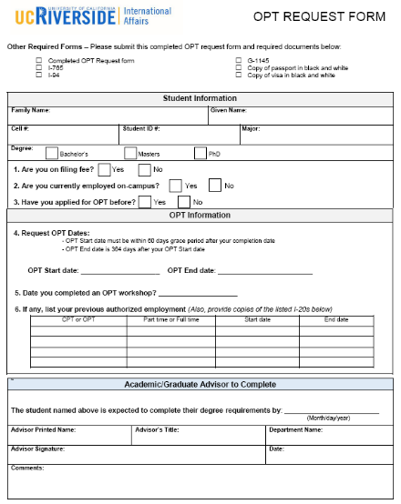
OPT Request Form
To be completed by: Student
Available at the ISS Office or email us at internationalstudents@ucr.edu
To be completed by:
Academic Advisor (UG) Graduate Advisor (Grad)
Notes:
Here is a closer look at the OPT Request Form.
As you can see, Section 1 and Section 2 will need to be completed by you, the student.
The last section will need to be completed by your Academic Advisor if you are an undergraduate student or your Graduate Advisor if you are a Graduate student

Slide 14
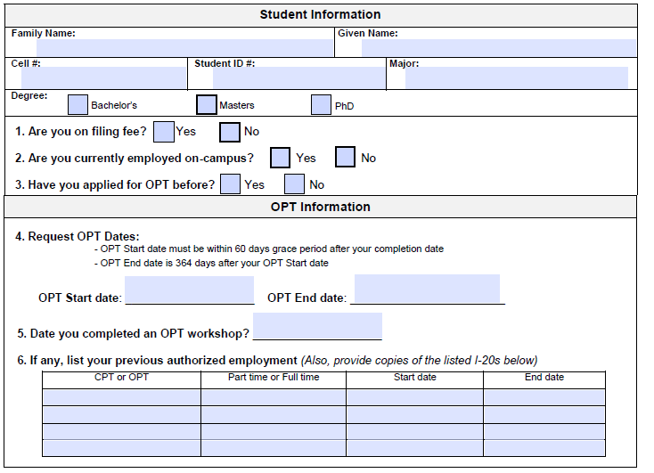
OPT Request Form
To be completed by: Student
Section 1.
Basic Student Information
Section 2.
OPT Information
OPT Request Dates
Dates that you are requesting to start your OPT
Cannot issue OPT I-20 without these dates
Notes:
In Section 1, it requires you to complete your student information.
In Section 2, it will ask you to enter your OPT information including the OPT dates that you are requesting to start and end OPT(as it is indicated in the red box). Please note that this information is a required in order for us to issue you an OPT I-20.

Slide 15
Selecting OPT Dates
Selecting an OPT Start Date
Completion
Date
60 days
Earliest OPT Start Date
The day after completion date
Latest OPT Start Date
60 days after completion date
OPT start date must be within your 60-day grace period.
Useful Resource to calculate your OPT dates:
https://www.timeanddate.com/
Notes:
Like mentioned, one of the most important parts of the OPT process is selecting your OPT start date and end dates. These dates will be added to your OPT I-20 which USCIS will review as a part of your application.
Please keep in mind that USCIS may or may not grant your OPT dates as it will depend on WHEN they receive your application.
When choosing an OPT start date, you can choose a date that can range from the day after your program end date up to the last day of your 60-day grace period.

Slide 16
Selecting OPT Dates
Selecting an OPT End Date
OPT Start Date
OPT End Date
12 months
JUNE 15, 2019
JUNE 14, 2020
14-Month OPT Rule
All standard post-completion OPT must be completed within the 14-month period following the completion of study.
If you submit OPT application later, you will lose some OPT time due to 14-month rule.
Recommended to apply as early as possible to maximize on OPT Time
Notes:
When selecting an OPT end date, you can choose an end date that is up to 12 months afterward your start date.
For example, if your OPT start date is June 15, 2019, then your OPT end date will be June 14, 2020
Please keep in mind that all Post-Completion OPT must be completed within a 14-month period following the completion of the study.
So, if you submit your OPT application later, then you may lose some OPT time and may not receive 12 months of OPT
We recommend that you plan ahead and apply as soon as possible to maximize on OPT time

Slide 17
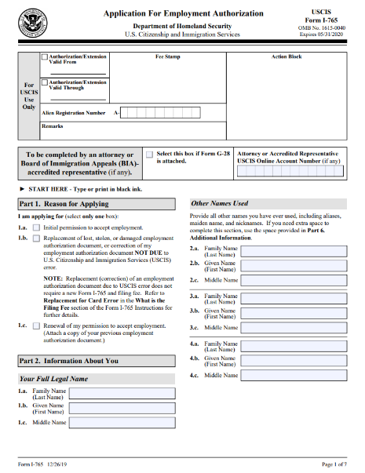

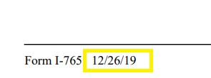
Form I-765
Form I-765 (pg 1 of 7)
Typed, not handwritten
Get most updated version from USCIS website
  Form I-765
Important Note: USCIS recently updated the I-765 version
Starting April 20, USCIS will only accept new version.
How to check if it’s the most updated version:
At the bottom of the I-765 form please look for this date:
Make sure “Initial permission to accept
employment“ is checked.
At the bottom of the page
Notes:
In this slide, we will discuss how to complete Form I-765.
Form I-765 is an application form for the Employment Authorization Document, also known as the EAD card
This form should be typed except for the signature portion
You can access the most updated version of the form through the USCIS website
Now, let’s take a look at how to complete the form..starting with Part 1.
If this is your first time applying for Post-Completion OPT category, please select #1a “Initial permission to accept employment”
If this is NOT your first time applying for Post-Completion OPT, please select #1c “Renewal of my permission of my permission to accept employment.
In Part 2, please complete your name.
If you have other names that are used, you can use the second column to complete.

Slide 18
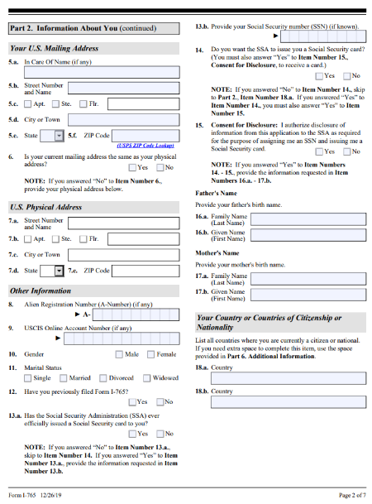
Form I-765
Form I-765 (pg 2 of 7)
Only complete 14-17 if you do not have a SSN and want USCIS to issue you a Social Security number and card.
The address you enter should be valid for at least 4-5 months into the future.
If no mailing address available,
you can use a P.O. Box (Postal Office Box).
USPS
UPS
Notes:
Now, let’s move on to page 2 of Form i-765
In Items #5 & 6, you will need to enter your U.S. mailing address. Please keep in mind that USCIS will be mailing your OPT notices and EAD card to this mailing address so, please make sure that this address is valid throughout your OPT application process.
If you are not sure if your mailing address will be valid throughout this time, then you have the option to add a trusted friend or family member’s U.S. address in that section. You can enter the name of the individual in Item #5a.
If you do not have a friend or family member with a permanent U.S. mailing address, then you have the option to rent a Postal Office Box, a P.O. Box.
If your current mailing address will be the same as your physical address, please select “Yes.” If your physical address will be different, please select “No” and enter your mailing address in Item#7.
In Item #8 and 9, if you do not know this information, you can skip these items.
In Item #10, please enter your gender
In Item #11, enter your marital status
In Item#12, if you have completed this form before please select “yes” and be sure to provide an explanation on why you completed this form before in page 6, Additional information section.
if you have not completed this form before, please select “no”
In Item #13a - if the Social Security Administration (SSA) has issued you an SSN card, please select yes and complete items #13b-14, and skip down to Item #18
If the SSA has NOT issued you an SSN card and you need one, please select “No”, skip #13a and complete items #14-18

Slide 19
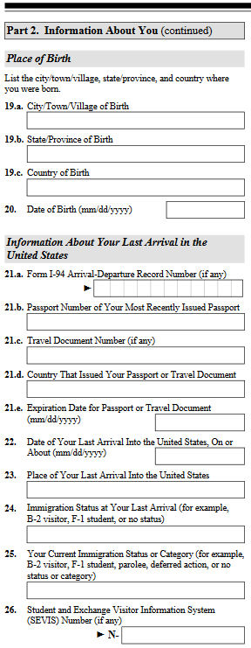
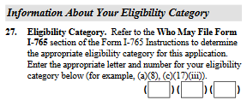
Form I-765
Form I-765 (pg 3 of 7)
Enter Post-Completion OPT Eligibility Code (c)(3)(B)
Leave questions 28a-31b blank
Enter the full city name (ex: Los Angeles, not LAX)
Enter F-1 Student
Enter F-1 Student
Notes:
Let’s take a look at page 3, Part 2
Please complete Items #19-20 by entering your place and date of birth
In Item #21a, please enter your most recent I-94 admission number
you can access this number through the I-94 website
In Item #21b, please enter your passport number or your most recently issued passport number
In Item #21c, if you do not have a travel document number- please skip this item
In Item # 21d & 21e, this information can be located in your passport
In Item #22- your date of last arrival in the U.S. can be found in your most recent I-94
In Item #23- you will need to enter the name of the city of where you last entered in the U.S, not the port of entry
For example, enter Los Angeles instead of LAX
In Item #24 and Item #25 - please enter F-1 student
And in Item #26- Please enter your SEVIS ID number located on the top of your Form I-20
And finally, in Item #27, you will need to enter the Post-Completion OPT code in each box which will be lowercase C, the number 3, and capitalize B
After that, you can skip the rest of the page

Slide 20
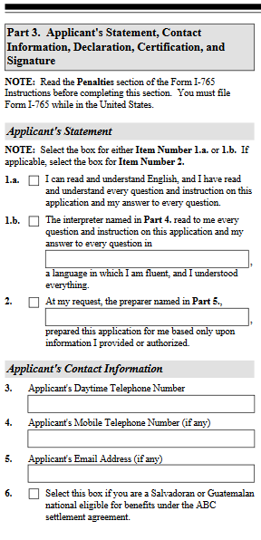
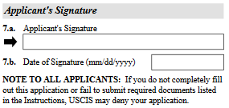
Form I-765
Form I-765 (pg 4 of 7)
Your signature goes here – stay within the box!
Skip pages 5 & 6 (if you check #1a)
Be sure to include all 7 pages when submitting to USCIS.
Enter contact information
Extremely important to use a permanent email address
Your Signature Here
Notes:
In page 4, if you are preparing this document yourself, please select #1a.
Items #3-5- please complete your contact information
In Item #7a, the application signature portion will be the only handwritten portion of the form.
please be sure to sign this document in black ink and inside the box
After that you will need to enter the date of signature and skip pages 5&6 if checked #1a. However, please be sure to include all seven pages of the document when submitting to USCIS.

Slide 21
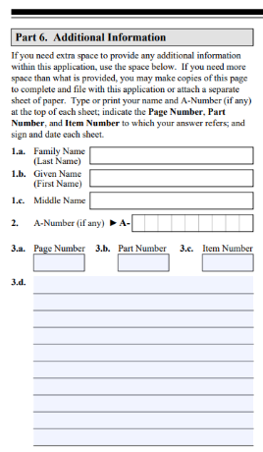
Form I-765
Form I-765 (pg 7 of 7)
Complete Part 6.( Additional Information) if these items apply:
You do not have enough space to answer in Parts 1~5
  Ex. Name
CPT Authorizations
Previous OPT Authorizations
OPT Denials
Previous SEVIS IDs
Your Signature Here
Notes:
In Page 7, Part 6 of the Form I-765, this section is useful if you need additional space to explain certain items.
These items can be any of the following:
if you need more space to answer a certain question such as your name
if you had any CPT authorization
if you had previous OTP authorizations or denials
or if you had a different SEVIS ID number in the past
In the next few slides, we will provide you with a template that you can use to easily explain any of the items above.

Slide 22
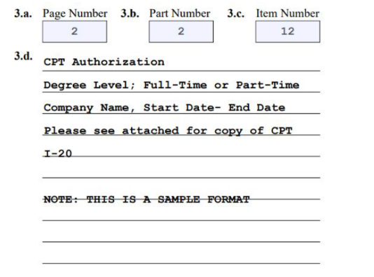
Form I-765
Form I-765 (pg 7 of 7)
Part 6.( Additional Information)
CPT Authorization
Items a~c : Reference Page
Item d: Use below format
CPT Authorization
Employer; Start date - End Date; PT or FT; Degree level
Add text “Please refer to copy of CPT I-20”
3
27
Your Signature Here
Notes:
If you had a CPT authorization while you were studying at UCR, you will use this template to complete these items.
The first three boxes in items #3a-3c will be used to detail what you will explaining
In Item #3d, please use CPT Authorization as a title and enter the rest of the information per your CPT authorization.
Lastly, please be sure to attach a copy of your CPT I-20.

Slide 23
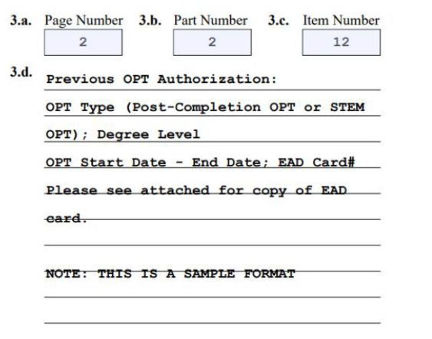
Form I-765
Form I-765 (pg 7 of 7)
Part 6.( Additional Information)
OPT Authorization
Items a~c : Reference Page
Item d: Use below format
OPT Authorization
Start date - End Date; Degree level
Add text “Please refer to copy of EAD card”
Your Signature Here
Notes:
If you had a previous OPT authorization, you will use this template to complete these items.
The first three boxes in items #3a-3c will be used to detail what you will explaining
In Item #3d, please use Previous OPT Authorization as a title and enter the rest of the information per your past OPT authorization.
Lastly, please be sure to attach a copy of your EAD card.

Slide 24
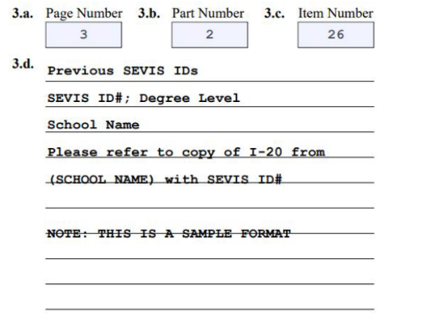
Form I-765
Form I-765 (pg 7 of 7)
Part 6.( Additional Information)
Previous SEVIS IDs
Items a~c: Reference Page
Item d: Use below format
Previous SEVIS IDs
Previous SEVIS number; Program start- end date; Degree level
Add text “Please refer to copy of I-20 from (school name) for SEVIS Number N00________”
Your Signature Here
Notes:
If you had a previous SEVIS ID number, you will use this template to complete these items.
The first three boxes in items #3a-3c will be used to detail what you will explaining
In Item #3d, please use Previous SEVIS ID as a title and enter the rest of the information per your previous SEVID ID number
Lastly, please be sure to attach a copy of your I-20 with that SEVIS ID number

Slide 25
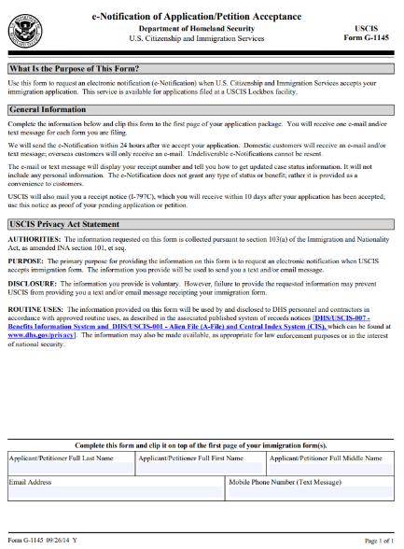
Form G-1145
Form G-1145
Strongly Recommended
To receive eNotifications on your application from USCIS
Your Signature Here
Notes:
The Form G-1145 will need to be completed if you would like to receive eNotifications regarding your OPT application.
This document is not require but, we strongly recommend all students to submit this.
Please be sure to type out your information

Slide 26
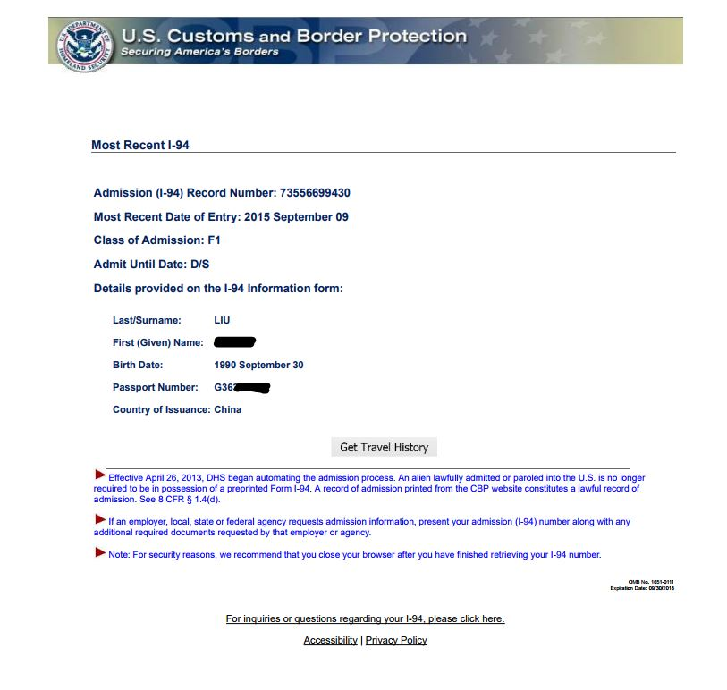
I-94
To access your I-94, go to:
https://i94.cbp.dhs.gov/I94/#/home
Notes:
The I-94 is an arrival-departure record of your travel to and from the U.S.
To access your most updated I-94, you can go to the official I-94 CBP website and get an electronic copy

Slide 27
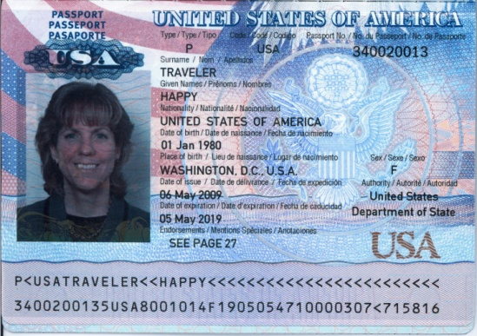

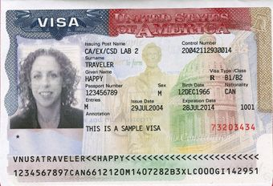
Passport and Visa
Provide a copy of your passport and most recent visa. The photocopies should not be too large or too small.
Passport
Copy should not be enlarged or minimized
Visa
Copy of most recent visa
Does not have to be valid
Copy should not be enlarged or minimized
PASSPORT NUMBER
SCOTTY HIGHLANDER
SCOTTY HIGHLANDER
SCOTTY HIGHLANDER
F-1
SCOTTY HIGHLANDER
Notes:
You will also need to provide a copy of your passport and your most recent F-1 Visa stamp
The copy that you provide should be a clear copy and should not be too enlarged or minimized
Please note that your F-1 visa does not have to be valid at the time of your OPT application

Slide 28
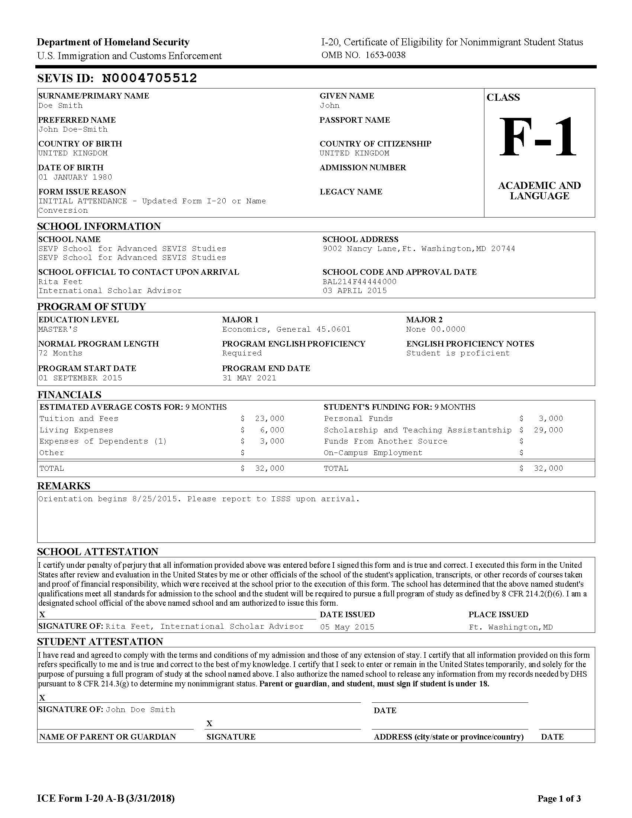
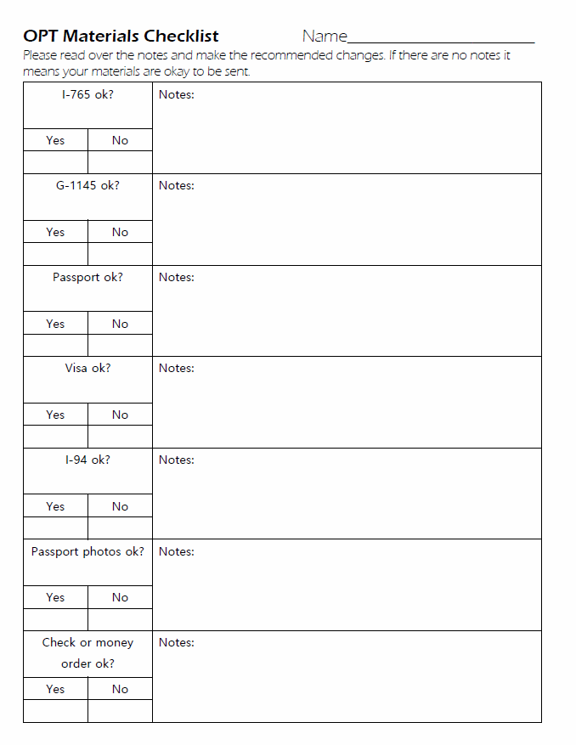
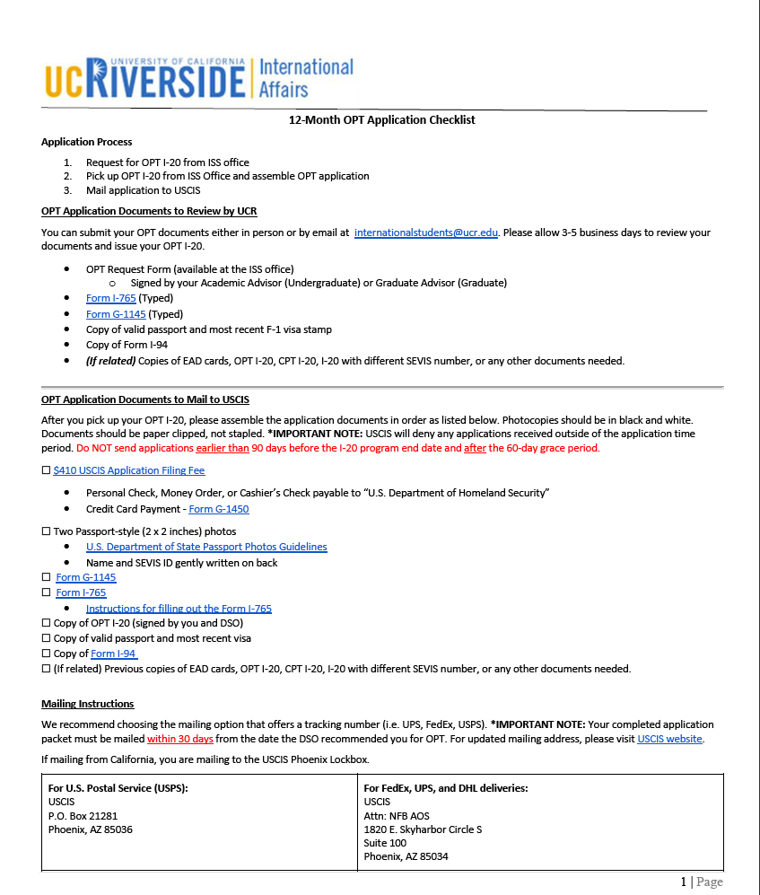
OPT I-20 issued by ISS
OPT I-20
OPT Materials Checklist
Instructions After I-20
Notes:
Once your documents are reviewed, an ISS advisor will issue you documents including:
an OPT I-20
an OPT Materials Checklist - this will include the advisor’s recommendations on your OPT documents
and finally an OPT Application checklist

Slide 29
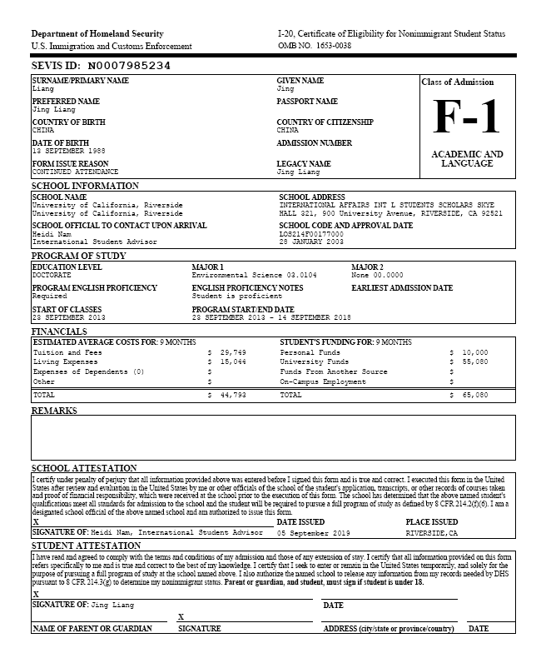
OPT I-20 issued by ISS
When you receive your OPT I-20,
OPT I-20 will include:
  OPT Recommendation by ISS
  Travel Signature
Double-check information before signing
Make photo copy
Keep in mind the 30-Day Ruling!
OPT recommendation must be less than 30 days old by the time USCIS receives your application
  Confirm with ISS Advisor for recommendation date
USCIS has become strict about this rule
  Automatic OPT Denial
  Keep this in mind for USCIS RFEs
OPT I-20 ISSUE DATE
Notes:
Once you receive your OPT I-20, it will include: the OPT recommendation and a travel signature
Before you sign the I-20, please double-check to see if all of the information is correct and make a photocopy
Please keep in mind that OPT applications must be mailed to USCIS within 30 days of the OPT I-20 issue date
You can check where the OPT I-20 issue date is at the bottom of the I-20 (as shown in the image)
USCIS has become very strict about this rule so, please keep an eye on this

Slide 30
Documents to mail to USCIS
(External process)
Assemble your final packet in this order. Do not staple documents.
$410 made payable to “U.S. Department of Homeland Security” - A personal check, cashier’s check, or money order
Two 2x2 passport photos
Form G-1145 (Typed)
Form I-765 (Typed and Signed)
Copy of OPT I-20 (Signed)
Copies of the valid passport, most recent visa, recent I-94
(If related) Previous copies of CPT I-20, OPT I-20, EAD cards, previous I-20 if SEVIS ID is different, or any other documents needed
Notes:
Now that you have received your OPT I-20, you can assemble your final packet to mail to USCIS.
Please be sure your documents in this order and do not staple them together

Slide 31

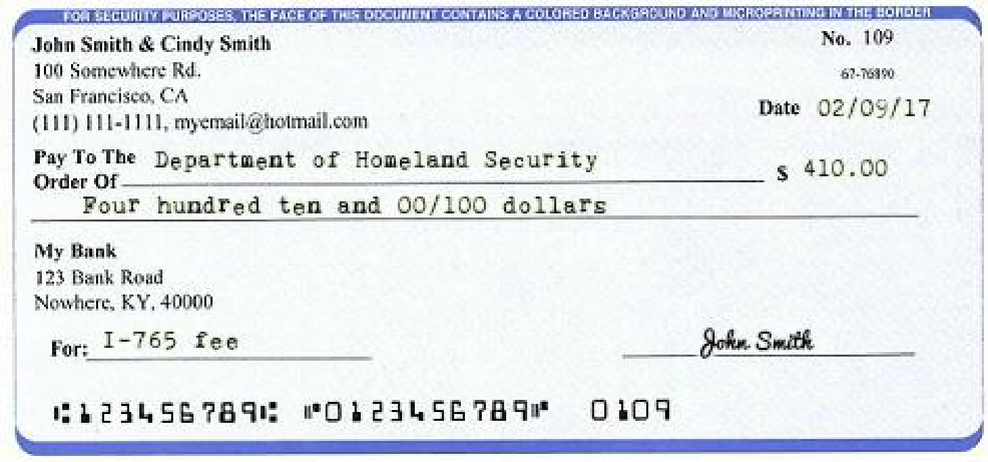
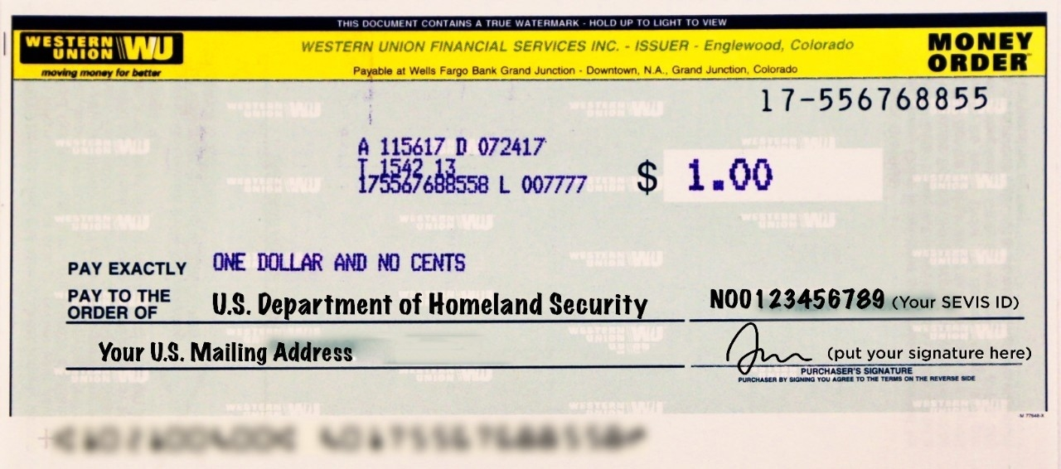
USCIS Application Filing Fee
$410 USCIS Application Filing Fee
Payable to:
U.S. Department of Homeland Security
Acceptable payment methods:
Personal Check
Money Order
Cashier’s Check
Credit Card (Form G-1450)
Personal Check - Must be from a U.S. Bank
Recommended
Money Order
Money Orders can be purchased at:
Banks
Post-offices
Local markets (i.e. Albertsons)
Local pharmacies (i.e. CVS)
Notes:
On top of the packet, you will need to include a $410 application fee to USCIS
Some acceptable payment methods include personal check, money order, cashier’s check, and credit card payment.
The most recommended methods of payment are as indicated in the slide
The fee should be payable to “U.S. Department of Homeland Security” and the fee should indicate your name
For credit card payment, you can complete the Form G-1450 available on the USCIS website.
Please keep in mind that the credit card will need to be U.S. issued

Slide 32

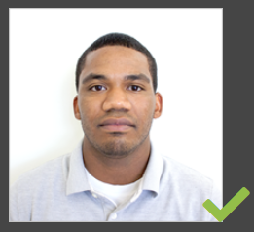

U.S. Passport-Style Photos
Prepare 2 passport-style photos
Must meet specifications on U.S. Department of State website
Must be a recent photo (taken within 30 days)
Clip the photo and application fee to top of application packet
U.S. Department of State Criteria
Correct Passport Size and Position:
2 x 2 inches (51 x 51 mm)
The head centered and sized between 1” and 1.4” (25 and 35 mm)
Background:
Plain and white or off-white
No shadows
Shadows and Lighting:
Clear and in color
No shadows
Not digitally altered
Accessories:
No glasses
No hats or head coverings
(unless for religious or medical purposes)
(On the back of photos)
Gently write your name and I-94 number
Where can you take passport photos ?
Costco (most affordable option)
U.S. Postal Service
Local drugstores (i.e. Walgreens, CVS, Rite Aid)
Notes:
You will also need to provide 2 passport-style photos
The photos must be 2x2 and must meet specifications of the U.S. Department of State
Once you have your passport photos, you can write your name and I-94 or SEVIS ID number on the back of the photo.
You can take passport photos at your local drugstore or U.S. postal service.

Slide 33
Mailing your OPT Application
Do not staple your documents
Recommended to receive tracking number
Go to USCIS website for most updated Direct Filing Address
USCIS Phoenix Lockbox (If mailing from CA)
For U.S. Postal Service (USPS):
USCIS
P.O. Box 21281
Phoenix, AZ 85036
For FedEx, UPS, and DHL deliveries:
USCIS
Attn: NFB AOS
1820 E. Skyharbor Circle S
Suite 100
Phoenix, AZ 85034
Notes:
Once you have assembled your OPT application, please make sure to clip and not staple your documents.
It is also recommended to receive a tracking number when mailing your documents.
The USCIS mailing address will depend on the state you are mailing from and also the type of shipping service you are using so, please make sure to double check the mailing address on the USCIS website.

Slide 34
Application Procedure
USCIS reviews your application, cashes your check and assigns a case number.
Student can start working with EAD card and update OPT Portal
USCIS Sends students an I-797 Receipt Notice
(14-30 days)
2. EXTERNAL PROCESS
USCIS Sends students an EAD and Approval Notice
(90-150 days)
If OPT Portal link expired or have issues, contact ISS office.
You could also request an SS # card on I-765.
(14-30 days)
SEVP sends OPT Portal link to student’s UCR email
(around EAD start date)
Notes:
Now, for the external process.
Once USCIS receives your application, they will review it, process your payment, and assign a case number.
In about 2-3 weeks, USCIS will mail you a paper I-797 receipt notice.
Within 3-5 months, USCIS will mail you an EAD card and approval notice to your mail.
If you applied for a social security card, you will be mailed an SSN card separately shortly after.
Around the start date of your EAD card, SEVP will email you a OPT Portal link so, please make sure to keep an eye on your UCR email.
If the OPT Portal link expired, please contact the ISS office so that we can reset the link
Once the portal is set up, you can begin working around the start date of your EAD card.

Slide 35
Track Your Application
Form G-1145 (USCIS Email Updates)
Check USCIS Case Status Online: https://egov.uscis.gov/casestatus/landing.do
Notes:
Once you receive your I-797 receipt notice, you can track your application by receiving a notifications through the G-1145 form you submitted and by entering your case number in the USCIS case status online website.

Slide 36
While OPT Application is Pending...
Keep in mind
USCIS Processing Time: 90-150 days
  Expedited processing may not be approved
Do not work/volunteer while you are waiting for EAD card after your I-20 program end date
International Travel is not recommended
Notes:
While you are waiting for your OPT application to be approved, please keep in mind:
It might take 3-5 months for USCIS to process your application
Do not work or volunteer while you are waiting for your EAD card
And it is also not recommended to travel internationally during this time

Slide 37
International Travel and OPT
Notes:
Now we will speak about international travel during OPT

Slide 38

International Travel and OPT
While OPT is pending
Not Recommended - need to respond to RFEs on time
Higher Risk- dependent on the CBP officers
After OPT is approved
Recommended to travel after OPT is approved
Important Travel Documents to carry upon return to the U.S.
Valid Passport (within 6 months)
Valid F-1 Visa stamp
Form I-20 w/ Travel Signature
EAD card
Supporting Documents:
  Job offer letter, Employment Verification Letter, or Proof of Job Interview
  Financial Support Documents
Notes:
While your OPT is pending, it is not recommended to travel internationally as USCIS may send you notices or letters that require a timely response. There is also a higher risk when re-entering the U.S. without an approved OPT. If you do need to travel internationally, please speak with an ISS advisor.
After your OPT is approved, we recommend that you travel internationally during this time. Please make sure to gather the necessary materials (as listed in this slide) upon your travel back to the U.S.

Slide 39
USCIS Decision
Notes:
In this section, we will walk through different types of USCIS decisions.

Slide 40
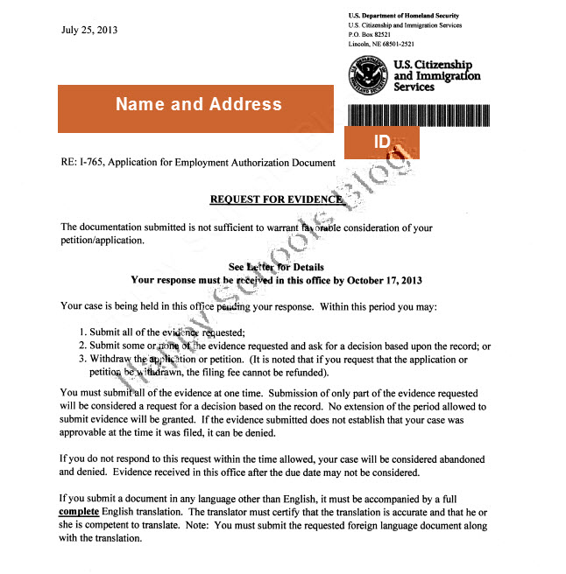
Request for Evidence (RFEs)
If USCIS needs more information/evidence, they will send an RFE.
Contact ISS office and work with an International Student Advisor
Remember! RFEs must be answered by deadline date on letter
Check OPT I-20 recommendation date before mailing RFE
  If outside 30 day window, request for a new OPT recommendation I-20.
RFE Deadline Date
Please contact ISS office to review required RFE documents
Notes:
If USCIS needs more information or documents, they will typically send a Request for Evidence, also known as RFE.
Please keep in mind that this is NOT a denial. It just simply means that they need more information.
An RFE will have a deadline date in which the needed documents will need to be received by. This letter will detail what items are needed.
If you receive this letter, please speak to an ISS advisor.

Slide 41
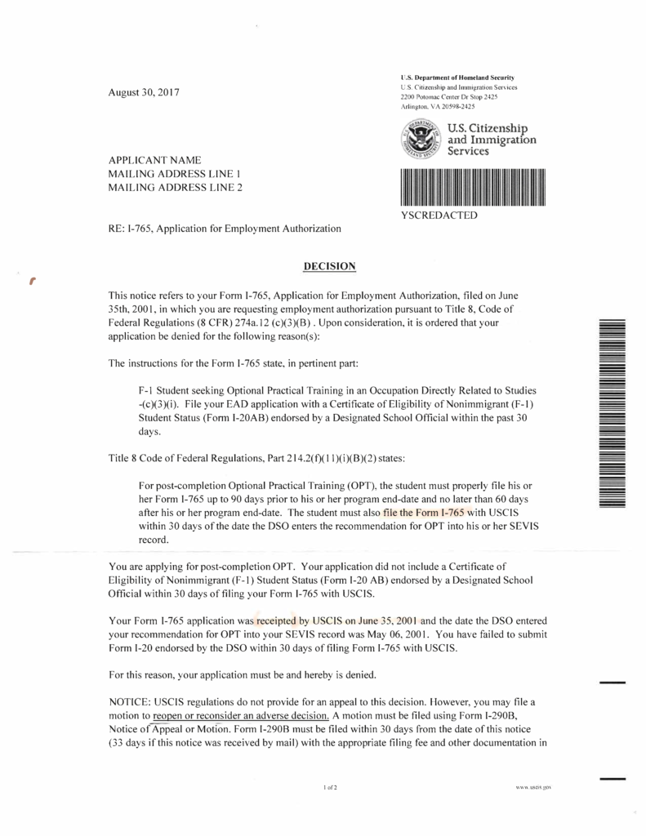
OPT Denials
Common Reasons for Denials:
USCIS receives OPT application too early or too late
Payment problems
RFE was not received by deadline date
RFE was answered but, OPT I-20 was already past 30 days of recommended date
Application was received on time but, OPT I-20 was past 30 day recommended date
I-765 was not signed or had incorrect information
Please contact ISS office immediately to discuss F-1 options
Notes:
If USCIS does NOT approve your OPT application, they will send an OPT Denial letter.
If you receive this letter, please contact an ISS advisor immediately so that you can discuss your F-1 options.

Slide 42
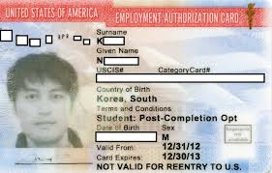
OPT Approvals- EAD Card
Employment Authorization Document (EAD) Card
  90-day Unemployment Days
  Can start work from start date
  Make sure information is accurate!
Email copy to internationalstudents@ucr.edu
Required for re-entry to the U.S.
Access to set up SEVP OPT Portal
HIGHLANDER
SCOTTY
SCOTLAND
EAD Card (Proof of Work Authorization)
Notes:
If your OPT is approved, you will receive an Employment Authorization Document, also known as an EAD card.
Once you receive the EAD card, please email a copy to the ISS office.
The EAD card is your proof of work authorization and will indicate your official OPT start and end dates.
You will also need to have this card to re-enter the U.S. when traveling internationally.

Slide 43
OPT Reporting Requirements
Notes:
In this section, we will talk about OPT Reporting Requirements.

Slide 44
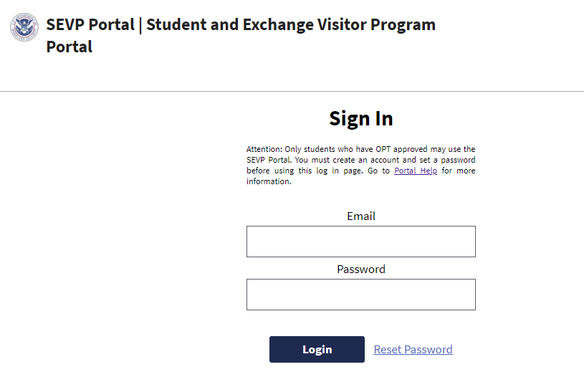
SEVP OPT Portal
Once OPT is approved,
SEVIS will email you link to set up SEVP OPT Portal
  Check UCR email address
  If link expires, contact ISS
Easy & convenient way to update:
  Employer information
  Personal information
Important for OPT Reporting Requirements
  Update any changes within 10 days
  Do not need to update through ISS
Notes:
Around the start date of your EAD card, SEVIS will email you a link to set up your SEVP OPT portal to your UCR email address.
If the link expires, please contact the ISS office.
The SEVP OPT Portal is an easy and convenient way for students to update their employer and personal information during OPT. Student no longer need to update changes to the ISS and will just need to update the portal. Please keep in mind that any changes must be reported within 10 days of that change.

Slide 45
Reporting OPT Employment
F-1 OPT students must provide a description on how the employment position has a direct relation to their major of study.
Examples
Bachelor's degree in Electrical Engineering: I work full time as an Electrical Engineer at ABC Corp., a government contractor. In my job, I analyze client requirements for electrical systems and provide them with cost estimates of such systems. My work requires understanding of electrical circuit theory, which I studied in-depth at the University of ABC. dissertation
Notes:
When reporting your OPT employment position in the portal, you must provide a description of how the employment is directly related to your field of study.
Here is an example of a description for a bachelor student.

Slide 46
Reporting OPT Employment
Examples Continued
Master's degree in Kinesiology: I am working 25 hours a week in a health food store as a consultant for Self-Made Inc., designing and teaching exercise classes that are incorporated into a customer's overall nutrition and exercise plan. My designs and customer instruction draw upon my studies and classwork in exercise therapy and physical reconditioning.
PhD in Computer Science: I am employed as a Computer and Information Research
Scientist at ABC Research Institute. I work as part of a team of scientists and engineers that
designs experiments to test the operation of various software systems. My work builds on
research in complex algorithms and machine learning, which I studied as part of my
dissertation
Notes:
Here are examples of OPT employment descriptions for a masters and a PhD student.

Slide 47
90-Day Unemployment
May have up to 90 days of unemployment
Unemployment days start from EAD card start date
Do not accumulate more than 90 days of unemployment
  Jobs that are less than 20 hrs per week will count towards unemployment days
Remember to update OPT Portal
HIGHLANDER
SCOTTY
SCOTLAND
EAD Card Start Date
EAD Card (Proof of Work Authorization)
Notes:
Once you are approved for OPT, you will have up to 90 days of unemployment.
Unemployment time will start from the EAD card start date.
It is important to not accumulate more than 90 days unemployment
That is why it is important to update your OPT employment through the OPT portal

Slide 48
Allowable Employment During OPT
Position must be related to field of study
Part-Time or Full-Time
  At least 20 hrs per week
Employment Types:
  Paid or Unpaid/Volunteer
  Self-Employed Business Owner
  Multiple
  Short-Term
  Through a Third-Party Agency
Remember to update employment information through OPT Portal!
Notes:
When looking for an employment during OPT, the position must be related to your field of study
The position can be part-time or full-time. However, it must be at least 20 hrs per week.
Some allowable employment types includes: paid or unpaid positions, self-employment, multiple, short-term, or positions obtained through a third-party agency.

Slide 49
After OPT Ends
Notes:
In this last section, we will talk about what you can do after your OPT ends.

Slide 50

After your OPT Ends
When the OPT ends, F-1 students will have a 60-day grace period to decide on their steps. During the 60-day grace period, students may decide on the following options:
Start a new program at UC Riverside
Transfer to another institution
Apply for a change of visa status
Return to home country
If you are planning on applying for STEM OPT Extension,
USCIS must receive your STEM OPT application before OPT EAD card expires
Notes:
After your OPT ends, you will have a 60-day grace period to decide on your next steps.
During the 60-day grace period, you can decide on the following options including:
starting a new degree program at UC Riverside
Transferring to another institution
applying for a change of visa status
or returning back to your home country
If you are STEM degree student, you also have the option to apply for STEM OPT Extension. Please keep in mind that you must apply for the STEM OPT Extension BEFORE your OPT expires.

Slide 51
Who can help you?
UCR International Students and Scholars Office
Email INTERNATIONALSTUDENTS@UCR.EDU
Office # 951-827-4113
Emergency # 951-206-8810
Office Hours 10:00AM - 12:00PM, 1:00PM - 4:00PM
Notes:
We hope that the information on OPT was helpful!
If you have any questions, please feel free to contact the UCR ISS office.

